Slide 1
Introduction to Statistical Methods
Faculty Name
Faculty Department

Slide 2
Lecture No. 14
Exponential Smoothing Methods

Slide 3
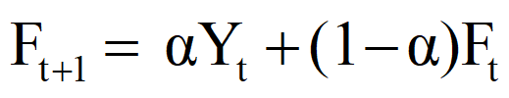
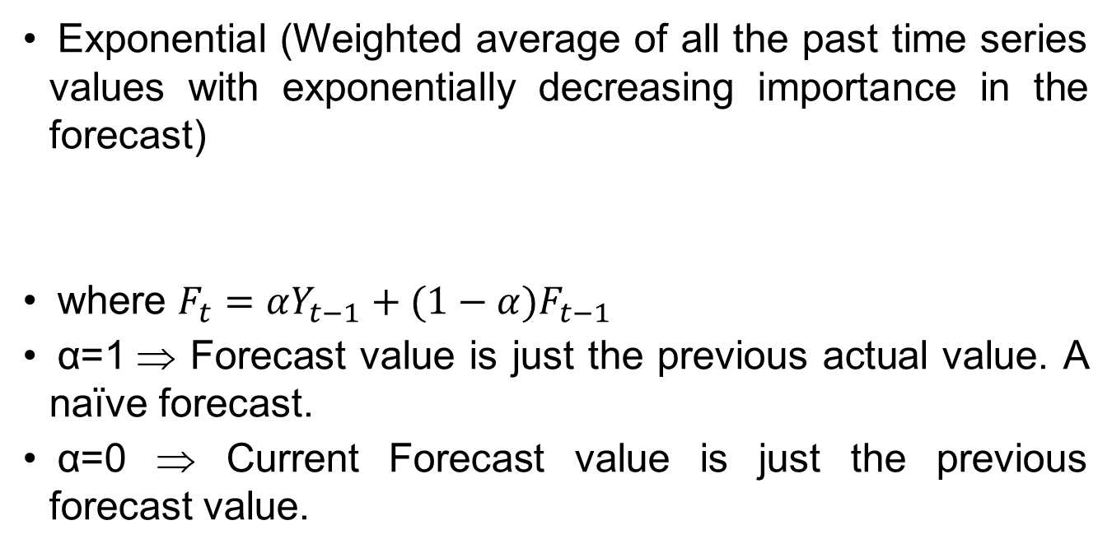
Time Series
Smoothing Techniques – Exponential
Exponential (Weighted average of all the past time series values with exponentially decreasing importance in the forecast)
where $F_{t}=αY_{t−1}+(1−α)F_{t−1}$
α=1 ⇒ Forecast value is just the previous actual value. A naïve forecast.
α=0 ⇒ Current Forecast value is just the previous forecast value.

Slide 4
Time Series
Exponential Smoothing Techniques
Calculate the exponentially smoothed series F_{t+1} from
the original time series Y_{t} as follows:
F₂ = Y₁
F₃ = αY₂ + (1 – α)F₂
F₄ = α Y₃ + (1 – α)F₃
F_{t+1} = α Y_{t} + (1 – α)F_{t}

Slide 5
Quar/Yr | Utilization(%)
Q1/2017 | 82.50
Q2/2017 | 81.30
Q3/2017 | 81.30
Q4/2017 | 79.00
Q1/2018 | 76.60
Q2/2018 | 78.00
Q3/2018 | 78.40
Q4/2018 | 78.00
Q1/2019 | 78.80
Q2/2019 | 78.70
Q3/2019 | 78.40
Q4/2019 | 80.00
Q1/2020 | 80.70
Q2/2020 | 80.70
Q3/2020 | 80.80
Q4/2006
F_{t} (α=0.2)
82.50
82.50
82.26
82.07
81.45
80.48
79.99
79.67
79.34
79.23
79.12
78.98
79.18
79.69
80.33
80.23
F_{t} (α=0.4)
82.50
82.50
82.02
81.73
80.64
79.02
78.61
78.53
78.32
78.51
78.59
78.51
79.11
80.14
81.25
81.05
F_{t} (α=0.7)
82.50
82.50
81.66
81.41
79.72
77.54
77.86
78.24
78.07
78.58
78.66
78.48
79.54
81.05
82.35
82.04
F_{t+1} = α Y_{t} + (1 – α)F_{t}

Slide 6






Quar/Yr | Utilization(%)
Q1/2017 | 82.50
Q2/2017 | 81.30
Q3/2017 | 81.30
Q4/2017 | 79.00
Q1/2018 | 76.60
Q2/2018 | 78.00
Q3/2018 | 78.40
Q4/2018 | 78.00
Q1/2019 | 78.80
Q2/2019 | 78.70
Q3/2019 | 78.40
Q4/2019 | 80.00
Q1/2020 | 80.70
Q2/2020 | 80.70
Q3/2020 | 80.80
Q4/2006
MSE
F_{t} (α=0.1)
82.50
82.50
82.38
82.27
81.94
81.41
81.07
80.80
80.52
80.35
80.18
80.01
80.01
80.18
80.45
80.33
6.36
F_{t} (α=0.2)
82.50
82.50
82.26
82.07
81.45
80.48
79.99
79.67
79.34
79.23
79.12
78.98
79.18
79.69
80.33
80.23
4.76
F_{t} (α=0.3)
82.50
82.50
82.14
81.89
81.02
79.70
79.19
78.95
78.67
78.71
78.70
78.61
79.03
79.83
80.75
80.61
3.94
F_{t} (α=0.4)
82.50
82.50
82.02
81.73
80.64
79.02
78.61
78.53
78.32
78.51
78.59
78.51
79.11
80.14
81.25
81.05
3.41
F_{t} (α=0.5)
82.50
82.50
81.90
81.60
80.30
78.45
78.23
78.31
78.16
78.48
78.59
78.49
79.25
80.47
81.69
81.45
3.07
F_{t} (α=0.6)
82.50
82.50
81.78
81.49
80.00
77.96
77.98
78.23
78.09
78.52
78.63
78.49
79.40
80.78
82.05
81.78
2.85
F_{t} (α=0.7)
82.50
82.50
81.66
81.41
79.72
77.54
77.86
78.24
78.07
78.58
78.66
78.48
79.54
81.05
82.35
82.04
2.71

Slide 7
Quar/Yr | Utilization(%)
Q1/2017 | 82.50
Q2/2017 | 81.30
Q3/2017 | 81.30
Q4/2017 | 79.00
Q1/2018 | 76.60
Q2/2018 | 78.00
Q3/2018 | 78.40
Q4/2018 | 78.00
Q1/2019 | 78.80
Q2/2019 | 78.70
Q3/2019 | 78.40
Q4/2019 | 80.00
Q1/2020 | 80.70
Q2/2020 | 80.70
Q3/2020 | 80.80
Q4/2006
MSE
F_{t} (α=0.8)
82.50
82.50
81.54
81.35
79.47
77.17
77.83
78.29
78.06
78.65
78.69
78.46
79.69
81.30
82.58
82.25
2.62
F_{t} (α=0.9)
82.50
82.50
81.42
81.31
79.23
76.86
77.89
78.35
78.03
78.72
78.70
78.43
79.84
81.51
82.76
82.42
2.56

Slide 8
Time Series
Measurement of forecast error
To try to determine which one of these forecasting methods gives the “best” forecast, we evaluate the “success” of each method using a performance measure
Each performance measure begins by evaluating the forecast errors Δ_{t} for each time period t given by

Slide 9
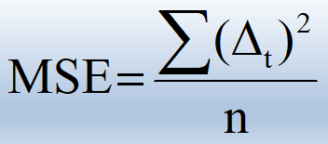
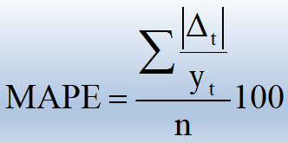
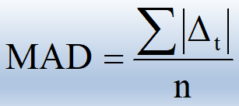
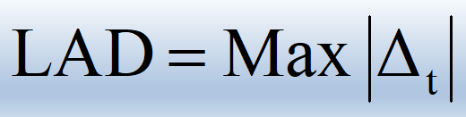
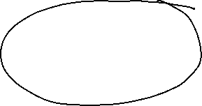
Time Series
Performance Measures
Mean Square Error (MSE)
Mean Absolute Percent
Error (MAPE)
Mean Absolute Deviation
(MAD)
Largest Absolute Deviation
(LAD)

Slide 10
Time Series
Exponential Smoothing Techniques
Select an exponential smoothing constant, α, between 0 and 1. Remember that small values of α give less weight to the current value of the series and yield a smoother series. Larger choices of α assign more weight to the current value of the series and yield a more variable series.

Slide 11
Quar/Yr | Utilization(%)
Q1/2017 | 82.50
Q2/2017 | 81.30
Q3/2017 | 81.30
Q4/2017 | 79.00
Q1/2018 | 76.60
Q2/2018 | 78.00
Q3/2018 | 78.40
Q4/2018 | 78.00
Q1/2019 | 78.80
Q2/2019 | 78.70
Q3/2019 | 78.40
Q4/2019 | 80.00
Q1/2020 | 80.70
Q2/2020 | 80.70
Q3/2020 | 80.80
Q4/2006
MSE
F_{t} (α=0.2)
82.50
82.26
82.07
81.45
80.48
79.99
79.67
79.34
79.23
79.12
78.98
79.18
79.69
80.33
80.23
4.76
F_{t} (α=0.4)
82.50
82.02
81.73
80.64
79.02
78.61
78.53
78.32
78.51
78.59
78.51
79.11
80.14
81.25
81.05
3.41
F_{t} (α=0.7)
82.50
81.66
81.41
79.72
77.54
77.86
78.24
78.07
78.58
78.66
78.48
79.54
81.05
82.35
82.04
2.71
Done the analysis on the previous problem for 3 different values of α
For α=0.7, it is better
The exponential smoothing does not have a significant initial delay like the Moving Av. where the initial k values are not smoothed
Formula can be rearranged as

Slide 12
Quar/Yr | Utilization (%)
Q1/2017 | 82.50
Q2/2017 | 81.30
Q3/2017 | 81.30
Q4/2017 | 79.00
Q1/2018 | 76.60
Q2/2018 | 78.00
Q3/2018 | 78.40
Q4/2018 | 78.00
Q1/2019 | 78.80
Q2/2019 | 78.70
Q3/2019 | 78.40
Q4/2019 | 80.00
Q1/2020 | 80.70
Q2/2020 | 80.70
Q3/2020 | 80.80
 | MSE
F_{t} (α=0.2)
82.50
82.26
82.07
81.45
80.48
79.99
79.67
79.34
79.23
79.12
78.98
79.18
79.49
79.73
79.94
∆_{t}²(α=0.2)
0.00
0.92
0.59
6.00
15.05
3.96
1.61
1.80
0.18
0.18
0.34
0.67
1.46
0.94
0.74
2.297
Δ _{t} = Y_{t} - F_{t}

Slide 13
Quar/Yr | Utilization (%)
Q1/2017 | 82.50
Q2/2017 | 81.30
Q3/2017 | 81.30
Q4/2017 | 79.00
Q1/2018 | 76.60
Q2/2018 | 78.00
Q3/2018 | 78.40
Q4/2018 | 78.00
Q1/2019 | 78.80
Q2/2019 | 78.70
Q3/2019 | 78.40
Q4/2019 | 80.00
Q1/2020 | 80.70
Q2/2020 | 80.70
Q3/2020 | 80.80
 | MSE
F_{t} (α=0.4)
82.5
82.02
81.73
80.64
79.02
78.61
78.53
78.32
78.51
78.59
78.51
79.11
79.74
80.13
80.4
∆_{t}²(α=0.4)
0.00
0.52
0.18
2.69
5.86
0.37
0.02
0.10
0.08
0.01
0.01
0.79
0.92
0.32
0.16
0.803
Δ _{t} = Y_{t} - F_{t}

Slide 14
Quar/Yr | Utilization (%)
Q1/2017 | 82.50
Q2/2017 | 81.30
Q3/2017 | 81.30
Q4/2017 | 79.00
Q1/2018 | 76.60
Q2/2018 | 78.00
Q3/2018 | 78.40
Q4/2018 | 78.00
Q1/2019 | 78.80
Q2/2019 | 78.70
Q3/2019 | 78.40
Q4/2019 | 80.00
Q1/2020 | 80.70
Q2/2020 | 80.70
Q3/2020 | 80.80
 | MSE
F_{t} (α=0.7)
82.50
81.66
81.41
79.72
77.54
77.86
78.24
78.07
78.58
78.66
78.48
79.54
80.35
80.6
80.74
∆_{t}²(α=0.7)
0.00
0.13
0.01
0.52
0.88
0.02
0.03
0.00
0.05
0.00
0.01
0.21
0.12
0.01
0.00
0.133
Δ _{t} = Y_{t} - F_{t}

Slide 15
Time Series
Exponential Smoothing Techniques
Done the analysis on the previous problem for 3 different values of α
For α=0.7, it is better
The exponential smoothing does not have a significant initial delay like the Moving Average, where the initial k values are not smoothed
Formula can be rearranged as
Quarter/ Year | Utilization (%) | F_{t} (α=0.2) | F_{t} (α=0.4) | F_{t} (α=0.7)
Q1/2017 | 82.50 | 82.50 | 82.50 | 82.50
Q2/2017 | 81.30 | 82.26 | 82.02 | 81.66
Q3/2017 | 81.30 | 82.07 | 81.73 | 81.41
Q4/2017 | 79.00 | 81.45 | 80.64 | 79.72
Q1/2018 | 76.60 | 80.48 | 79.02 | 77.54
Q2/2018 | 78.00 | 79.99 | 78.61 | 77.86
Q3/2018 | 78.40 | 79.67 | 78.53 | 78.24
Q4/2018 | 78.00 | 79.34 | 78.32 | 78.07
Q1/2019 | 78.80 | 79.23 | 78.51 | 78.58
Q2/2019 | 78.70 | 79.12 | 78.59 | 78.66
Q3/2019 | 78.40 | 78.98 | 78.51 | 78.48
Q4/2019 | 80.00 | 79.18 | 79.11 | 79.54
Q1/2020 | 80.70 | 79.49 | 79.74 | 80.35
Q2/2020 | 80.70 | 79.73 | 80.13 | 80.60
Q3/2020 | 80.80 | 79.94 | 80.40 | 80.74
 | MSE | 2.30 | 0.80 | 0.13
$$F_{t}=αY_{t}+(1−α)F_{t−1}$$

Slide 16
Time Series
Smoothing Techniques – Moving Averages
The Moving Average basically filters out rapid fluctuations .i.e. high frequency noise. Thus it acts as a low-pass filter.
We can choose the index of the MA filter by trial and error. Comparing the Forecast Accuracy for index selection.
For our eg., we find that MSE for the 2-Qtr filter is better
Quarter/Year | Utilization (%) | 2-Qtr MA | 3-Qtr MA | 4-Qtr MA
1/2003 | 82.50
2/2003 | 81.30 | 81.90 | 81.70
3/2003 | 81.30 | 81.30 | 80.53
4/2003 | 79.00 | 80.15 | 78.97 | 81.03
1/2004 | 76.60 | 77.80 | 77.87 | 79.55
2/2004 | 78.00 | 77.30 | 77.67 | 78.73
3/2004 | 78.40 | 78.20 | 78.13 | 78.00
4/2004 | 78.00 | 78.20 | 78.40 | 77.75
1/2005 | 78.80 | 78.40 | 78.50 | 78.30
2/2005 | 78.70 | 78.75 | 78.63 | 78.48
3/2005 | 78.40 | 78.55 | 79.03 | 78.48
4/2005 | 80.00 | 79.20 | 79.70 | 78.98
1/2006 | 80.70 | 80.35 | 80.47 | 79.45
2/2006 | 80.70 | 80.70 | 80.73 | 79.95
3/2006 | 80.80 | 80.75 |  | 80.55
 | MSE | 0.33 | 0.84 | 1.42

Slide 17
Statistical Methods for Data Science
Time Series
Smoothing Techniques – Moving Averages

Slide 18
Time Series
Smoothing Techniques – Moving Averages
The Moving Average basically filters out rapid fluctuations .i.e. high frequency noise. Thus it acts as a low-pass filter.
We can choose the index of the MA filter by trial and error. Comparing the Forecast Accuracy for index selection.
For our eg., we find that MSE for the 2-Qtr filter is better
Quarter/Year | Utilization (%) | 2-Qtr MA | 3-Qtr MA | 4-Qtr MA
Q1/2017 | 82.50
Q2/2017 | 81.30 | 81.90 | 81.70
Q3/2017 | 81.30 | 81.30 | 80.53
Q4/2017 | 79.00 | 80.15 | 78.97 | 81.03
Q1/2018 | 76.60 | 77.80 | 77.87 | 79.55
Q2/2018 | 78.00 | 77.30 | 77.67 | 78.73
Q3/2018 | 78.40 | 78.20 | 78.13 | 78.00
Q4/2018 | 78.00 | 78.20 | 78.40 | 77.75
Q1/2019 | 78.80 | 78.40 | 78.50 | 78.30
Q2/2019 | 78.70 | 78.75 | 78.63 | 78.48
Q3/2019 | 78.40 | 78.55 | 79.03 | 78.48
Q4/2019 | 80.00 | 79.20 | 79.70 | 78.98
Q1/2020 | 80.70 | 80.35 | 80.47 | 79.45
Q2/2020 | 80.70 | 80.70 | 80.73 | 79.95
Q3/2020 | 80.80 | 80.75 |  | 80.55
 | MSE | 0.33 | 0.84 | 1.42

Slide 19
Time Series
Smoothing Techniques – Moving Averages

Slide 21
Time Series
Smoothing Techniques – Moving Averages

Slide 22
Time Series
Smoothing Techniques – Exponential
Objective is to estimate the overall time series as a combination of long term trend and seasonality
Additive Model: X_{t} = F_{t} + S_{t} + ɛ_{t}
Multiplicative Model: X_{t} = F_{t} x S_{t} x ɛ_{t}
Multiplicative model can be converted to additive model by taking log. Other models are also possible
The trend and seasonality can be decomposed using smoothing and regression methods
Exponential smoothing is suitable with constant variance and no seasonality. Recommended for short-term forecast.
Another method for stationarizing the time series is by doing transformation .eg. Differencing

Slide 23
Time Series
Holt Double Exponential Smoothing Technique
⋇ The simple exponential smoothing forecast is a weighted
sum of actual value with 𝝰 and the forecast for the same
period with (1-𝝰). At 𝝰 =1, it is identical to the naïve forecast.
⋇ However the simple exponential smoothing forecasts lag the
actual time series values when the time series has a trend.
⋇ The trend makes it difficult for forecast to ‘keep up’ since
there is no account of changes in level from period to
period.
⋇ The Holt double exponential smoothing method adds the
ability to account for the trend component the time series in
addition to the level.

Slide 24
Time Series
Holt Double Exponential Smoothing Technique
⋇ Holt double exponential is a simple exponential smoothing
with a added trend components that helps fix the lag issues
⋇ Weights are used to smooth the level and trend.
⋇ Holt smoothed value calculation for the level is exactly same
calculation as in simple exponential smoothing
⋇ The trend component is a weighted difference between the
current smoothed level and the prior period smoothed level
plus prior trend.
⋇ Finally, the Holt double exponential smoothing forecast for
the next period is a sum of smoothed level and smoothed
trend of the current period.

Slide 25

Time Series
Holt Double Exponential Smoothing Technique
Y_{t}
L_{t} + T_{t-1}
Current smooth level
L_{t}
Current actual level
+
Prior forecast level
𝞪
1-𝞪
Forecast value
F_{t+1}=L_{t}+T_{t}
+
L_{t} - L_{t-1}
T_{t-1}
Current smoothed level – Prior smoothed level
+
Prior smoothed trend
Current smooth trend
T_{t}
𝞫
1-𝞫

Slide 26
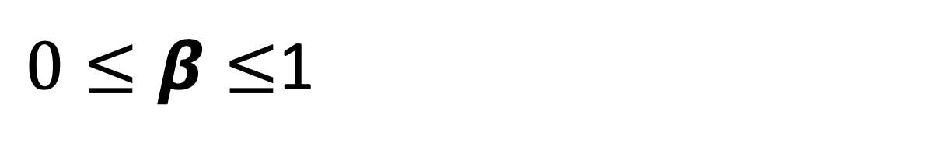
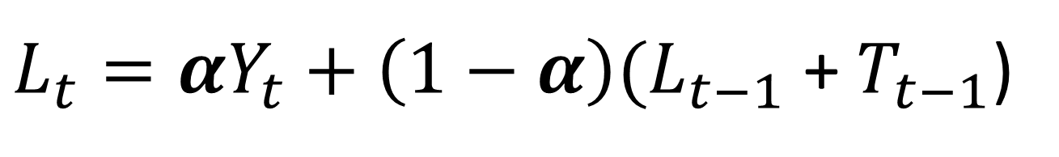
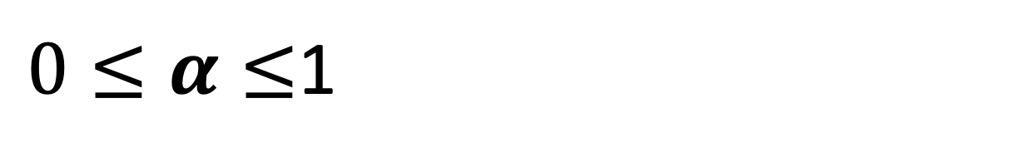
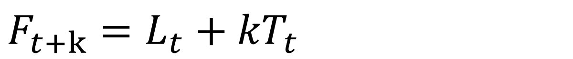
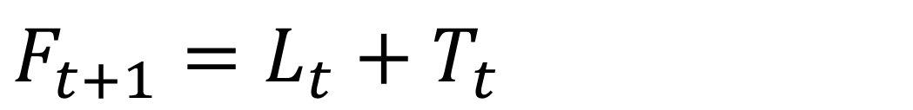
Time Series
Holt Double Exponential Smoothing Technique
Current smoothed level:
$L_{t}=αY_{t}+\left(1−α\right){(L}_{t−1}$ + $T_{t−1}$)
Current smoothed Trend:
$T_{t}=β{(L}_{t} \text{−} L_{t−1}\text{)}+\left(1−β\right)$ $T_{t−1}$
Forecast next period:
$$F_{t+1}=L_{t}+T_{t}$$
Forecast next k period:
$$F_{t+k}=L_{t}+{kT}_{t}$$
Level smoothing factor:
$0≤α≤$1
Level smoothing factor:
$0≤β≤$1

Slide 27
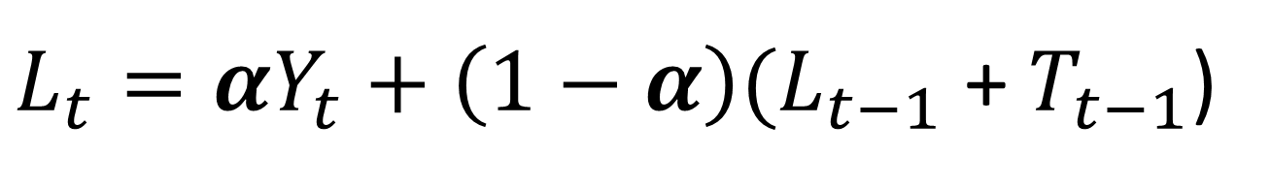
Time Series
Holt Double Exponential Smoothing Technique
Current smoothed level:
$L_{t}=αY_{t}+\left(1−α\right){(L}_{t−1}$ + $T_{t−1}$)
Level smoothing constant
Current data value
Prior period smoothed level
Prior period smoothed trend
Simple exponential smoothing

Slide 28
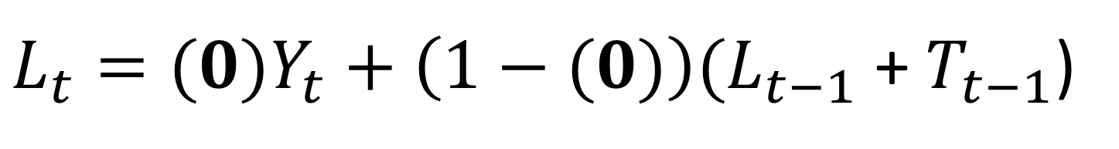
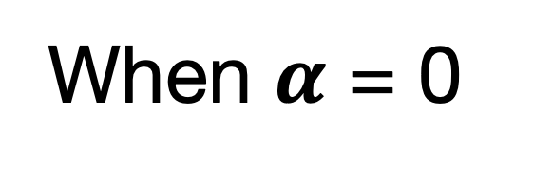
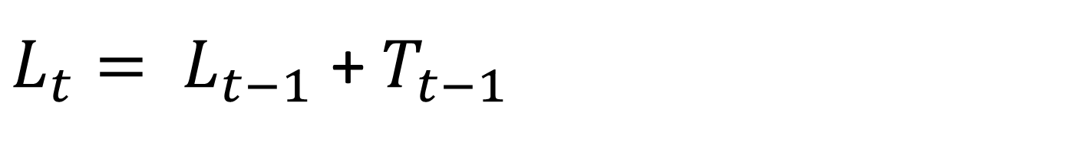
Time Series
Holt Double Exponential Smoothing Technique
When $α$ = 0
$L_{t}=(0)Y_{t}+\left(1−(0)\right){(L}_{t−1}$ + $T_{t−1}$)
$L_{t}= L_{t−1}$ + $T_{t−1}$
$L_{t}= F_{t}$
Smoothed level = Current forecast

Slide 29
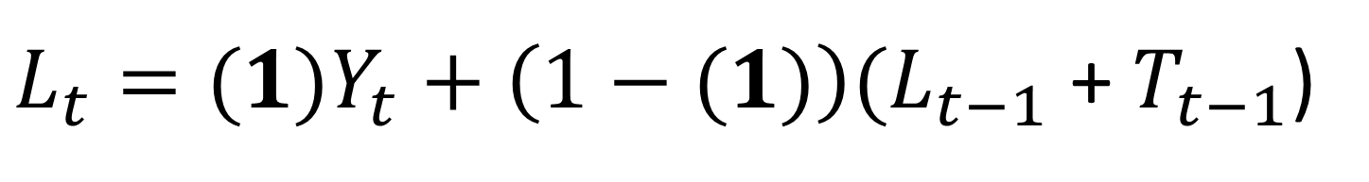
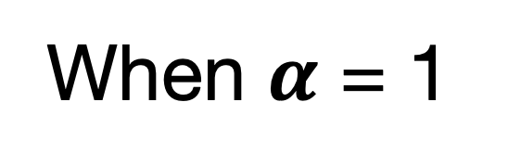
Time Series
Holt Double Exponential Smoothing Technique
When $α$ = 1
$L_{t}=(1)Y_{t}+\left(1−(1)\right){(L}_{t−1}$ + $T_{t−1}$)
$$L_{t}=Y_{t}$$
Smoothed level = Current actual level of the data

Slide 30
Time Series
Holt Double Exponential Smoothing Technique
Current smoothed trend:
$$T_{t}=β{(L}_{t} \text{−} L_{t−1}\text{)}+\left(1−β\right)T_{t−1}$$
Trend smoothing constant
Current smoothed level
Prior period smoothed level
Prior period smoothed trend

Slide 31
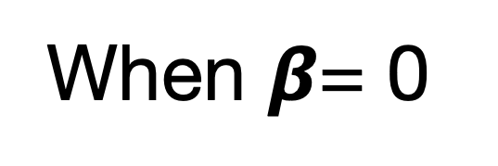
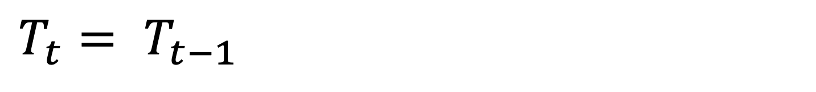
Time Series
Holt Double Exponential Smoothing Technique
When $β$= 0
$$T_{t}=β{(L}_{t} \text{−} L_{t−1}\text{)}+\left(1−β\right)T_{t−1}$$
$$T_{t}=(0){(L}_{t} \text{−} L_{t−1}\text{)}+\left(1−(0)\right)T_{t−1}$$
$$T_{t}= T_{t−1}$$
Smoothed trend = Trend from the last period

Slide 32
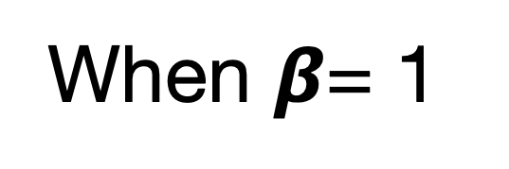
Time Series
Holt Double Exponential Smoothing Technique
When $β$= 1
$$T_{t}=β{(L}_{t} \text{−} L_{t−1}\text{)}+\left(1−β\right)T_{t−1}$$
$$T_{t}=(1){(L}_{t} \text{−} L_{t−1}\text{)}+\left(1−(1)\right)T_{t−1}$$
$$T_{t}=L_{t} \text{−} L_{t−1}$$
Current smoothed trend = Current smoothed level – prior smoothed level

Slide 33
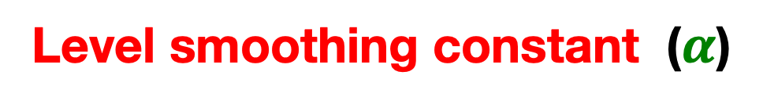

Time Series
Holt Double Exponential Smoothing Technique
Level smoothing constant ($α$)
0
1
Smoothed level is the same as actual level.
Trend is the full difference between smoothed level
1
Forecast all the same (flat line) of Y_{t}
Trend smoothing constant $(β)$
Forecast all the same (flat line) of Y_{t}
Same as Naïve fore cast, no trend component
0

Slide 34
Time Series
Holt Double Exponential Smoothing Technique
Level smoothing constant ($α$)
0
1
Actual
1
Forecast
Trend smoothing constant $(β)$
Actual
0
Forecast

Slide 35
Time Series
Holt Double Exponential Smoothing Technique
Example: Year & GDP
Year | 2000 | 2001 | 2002 | 2003 | 2004 | 2005 | 2006 | 2007 | 2008 | 2009 | 2010
GDP | 1451 | 1499 | 1686 | 1764 | 1879 | 1948 | 2013 | 2090 | 2173 | 2286 | 2404
Year | 2011 | 2012 | 2013 | 2014 | 2015 | 2016 | 2017 | 2018 | 2019 | 2020
GDP | 2465 | 2501 | 2597 | 2689 | 2688 | 2576 | 2530 | 2513 | 2503 | 2396

Slide 36
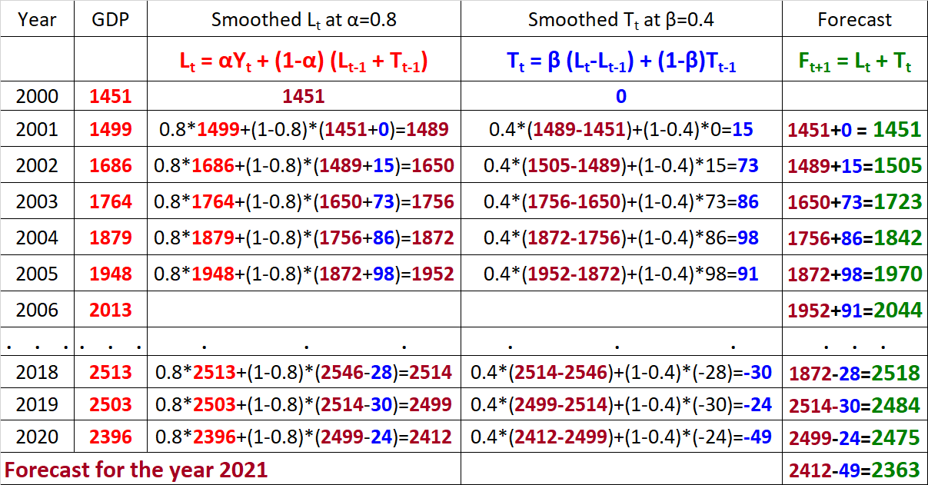









Time Series
Holt Double Exponential Smoothing Technique
Example: Year & GDP

Slide 37
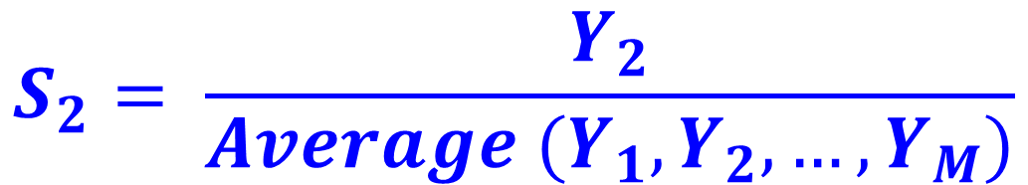
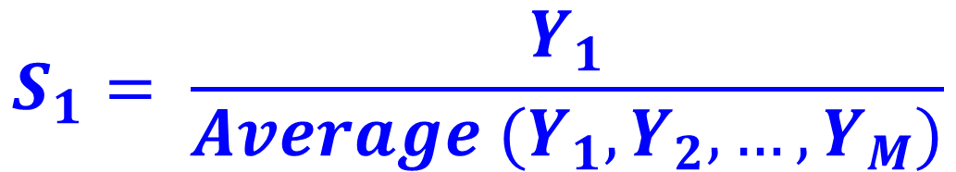
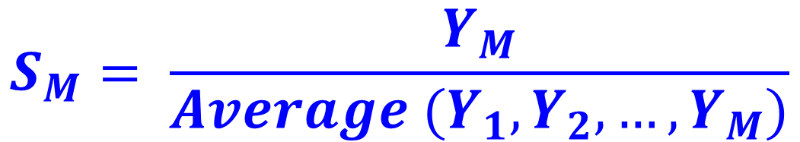
Time Series
Holts-Winters Triple Exponential Smoothing
Steps in calculation
M: No. of periods/ year (Quarterly (M=4), Monthly (M=12))
Initial seasonal factors:
$$S_{1}= \frac{Y_{1}}{Average (Y_{1},Y_{2},…,Y_{M})}$$
,
$$S_{2}= \frac{Y_{2}}{Average (Y_{1},Y_{2},…,Y_{M})}$$
,
. . .
$$S_{M}= \frac{Y_{M}}{Average (Y_{1},Y_{2},…,Y_{M})}$$

Slide 38
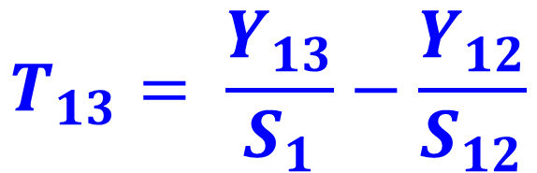
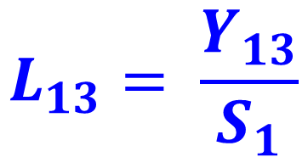
Time Series
Holts-Winters Triple Exponential Smoothing
Steps in calculation
M: No. of periods/ year (Quarterly (M=4), Monthly (M=12))
Initial level:
$$L_{13}= \frac{Y_{13}}{S_{1}}$$
Initial trend:
$$T_{13}= \frac{Y_{13}}{S_{1}}−\frac{Y_{12}}{S_{12}}$$

Slide 39
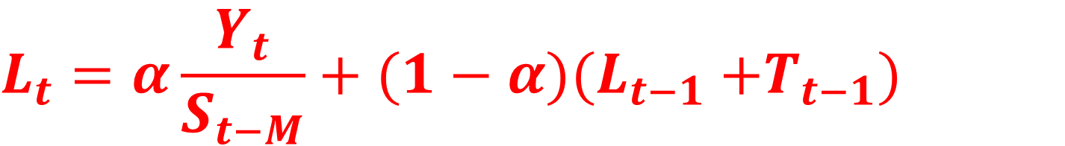
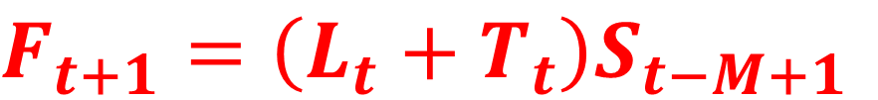
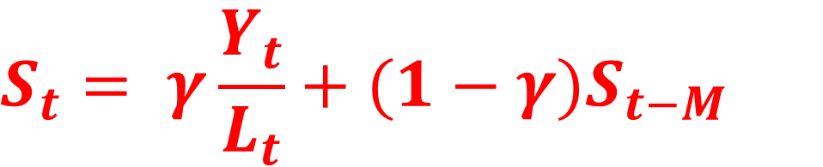
Time Series
Holts-Winters Triple Exponential Smoothing
Forecast
Level formula
$$L_{t}=α\frac{Y_{t}}{S_{t−M}}+(1−α)(L_{t−1}{ +T}_{t−1})$$
$$F_{t+1}=\left(L_{t}+T_{t}\right)S_{t−M+1}$$
Trend formula
$$T_{t}=β\left(L_{t}+L_{t−1}\right)+(1−β)T_{t−1}$$
Seasonal factor formula
$$S_{t}= γ\frac{Y_{t}}{L_{t}}+(1−γ)S_{t−M}$$

Slide 40
Time Series
Holts-Winters Triple Exponential Smoothing
Example on demand data
Period | 1 | 2 | 3 | 4 | 5 | 6 | 7 | 8 | 9 | 10 | 11 | 12 | 13 | 14
Year | 2011 | 2011 | 2011 | 2011 | 2012 | 2012 | 2012 | 2012 | 2013 | 2013 | 2013 | 2013 | 2014 | 2014
Quarter | 1 | 2 | 3 | 4 | 1 | 2 | 3 | 4 | 1 | 2 | 3 | 4 | 1 | 2
Demand | 362 | 385 | 432 | 341 | 382 | 409 | 498 | 387 | 473 | 513 | 582 | 474 | 544 | 582
Period | 15 | 16 | 17 | 18 | 19 | 20 | 21 | 22 | 23 | 24 | 25 | 26 | 27 | 28
Year | 2014 | 2014 | 2015 | 2015 | 2015 | 2015 | 2016 | 2016 | 2016 | 2016
Quarter | 3 | 4 | 1 | 2 | 3 | 4 | 1 | 2 | 3 | 4 | 1 | 2 | 3 | 4
Demand | 681 | 557 | 628 | 707 | 773 | 592 | 627 | 725 | 854 | 661

Slide 41
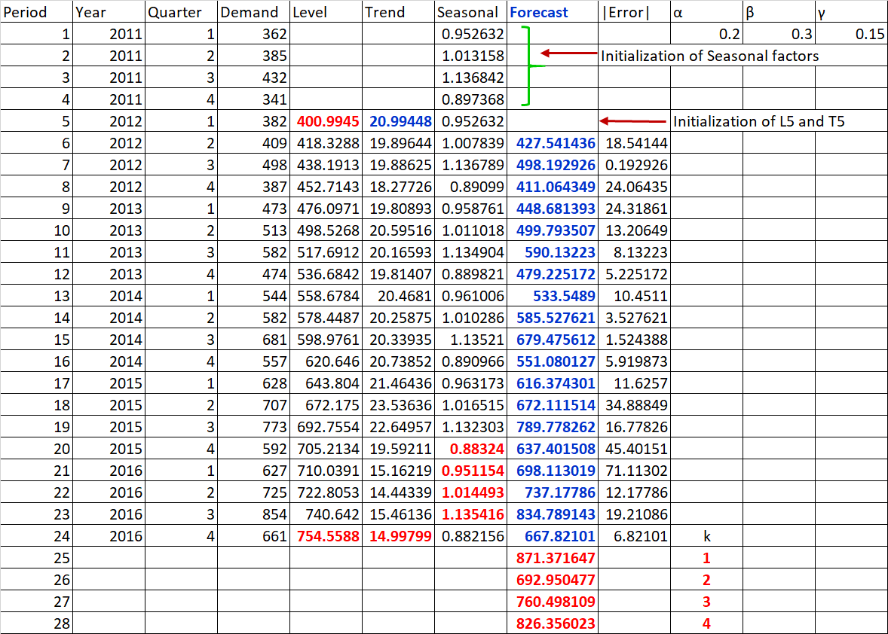

Slide 42
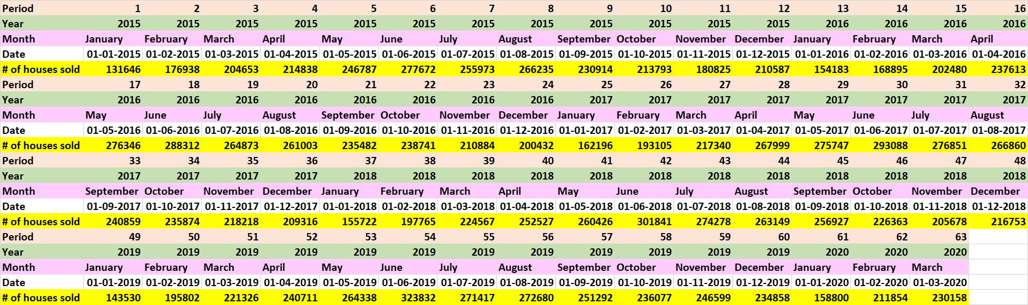
Example on seasonal sale of houses

Slide 43
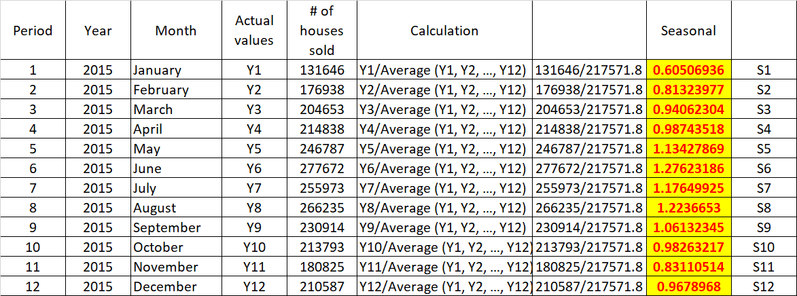

Slide 44
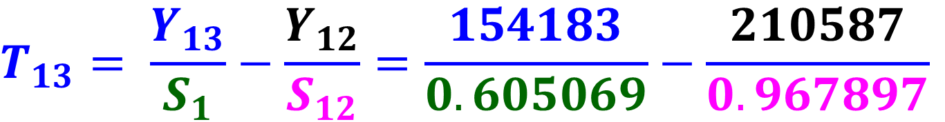
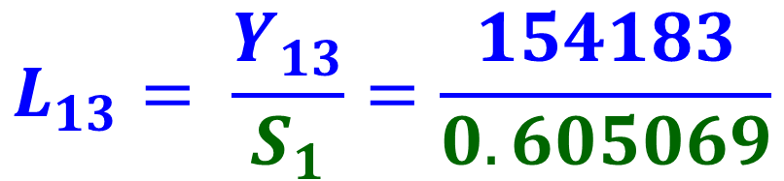


Time Series
Holts-Winters Triple Exponential Smoothing
Level | Seasonal
S1 | 0.605069
S2 | 0.81324
S3 | 0.940623
S4 | 0.987435
S5 | 1.134279
S6 | 1.276232
S7 | 1.176499
S8 | 1.223665
S9 | 1.061323
S10 | 0.982632
S11 | 0.831105
S12 | 0.967897
Period | Year | Month | # of houses sold | Level | Trend | Seasonal | Forecast | Error
12 | 2015 | December | 210587
13 | 2016 | January | 154183 | 254819 | 37247 | 0.605069
14 | 2016 | February | 168895 | 283627 | 36403 | 0.791464 | 237519 | -68624
$$L_{13}= \frac{Y_{13}}{S_{1}}=\frac{154183}{0.605069}$$
$$=254819$$
$$T_{13}= \frac{Y_{13}}{S_{1}}−\frac{Y_{12}}{S_{12}}=\frac{154183}{0.605069}−\frac{210587}{0.967897}$$
$$=37247$$

Slide 45
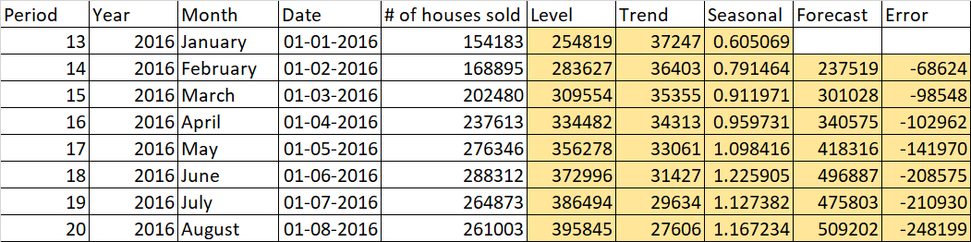

Slide 46
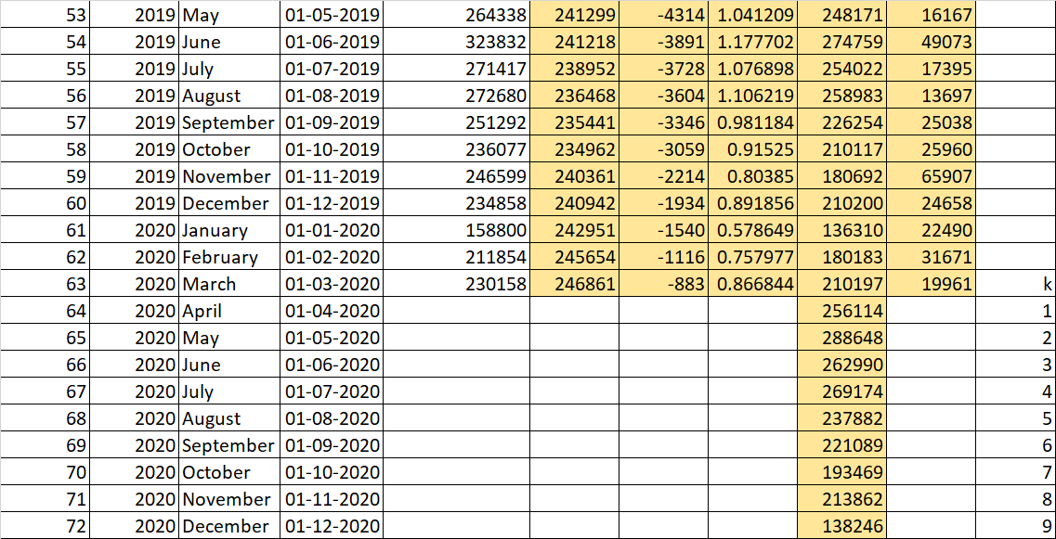

Slide 48
Time Series
Smoothing Techniques – Exponential
No trend
No seasonality

Slide 49
Time Series
Smoothing Techniques – Exponential
No trend
Linear seasonality

Slide 50
Time Series
Smoothing Techniques – Exponential
No trend
Ratio seasonality

Slide 51
Time Series
Smoothing Techniques – Exponential
No seasonality
Linear trend

Slide 52
Time Series
Smoothing Techniques – Exponential
Linear seasonality
Linear trend

Slide 53
Time Series
Smoothing Techniques – Exponential
Ratio seasonality
Linear trend

Slide 54
Time Series
Smoothing Techniques – Exponential
No seasonality
Ratio trend

Slide 55
Time Series
Smoothing Techniques – Exponential
Linear seasonality
Ratio trend

Slide 56
Time Series
Smoothing Techniques – Exponential
Ratio seasonality
Ratio trend

Slide 57
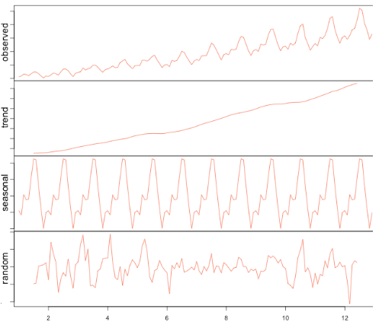
Time Series
Decomposition view

Slide 58
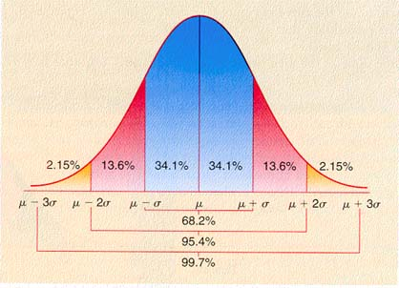
Thank you

